Slide 1

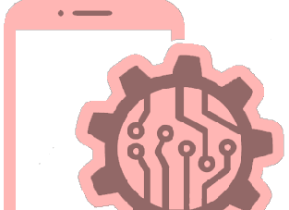


Lecture 1.1
Introduction to
Software Engineering
© LPU :: CAP437: SOFTWARE ENGINEERING PRACTICES : Ashwani Kumar Tewari

Slide 2

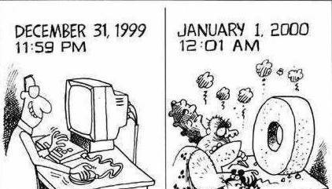
Y2K bug (millennium
bug)
▪
The Y2K bug was a computer
Flaw or
bug,
that
may
have
caused problems when dealing
with dates beyond
31, 1999.
December
▪
The
flaw,
faced
by
computer
users all
January 1,
programmers
and
over the world on
2000,
is
also
known
as
the
As the year
2000 approached,
"millennium bug..
computer programmers
realized that computers might not interpret
00 as 2000, but as 1900
▪
Computer
two-digit Instead of it read 70.
engineers
used
a
code
for
the
year.
1970,
a date reading
Darshan Institute of Engineering & Technology
© LPU :: CAP437: SOFTWARE ENGINEERING PRACTICES : Ashwani Kumar Tewari

Slide 3
Ariane 5 - One bug, one crash
It took the European Space Agency 10 years and $7 billion to produce Ariane 5, a giant rocket capable of hurling a pair of three-ton satellites into orbit with each launch and intended to give Europe overwhelming supremacy in the commercial space business.
Issue was a small computer program trying to stuff a 64-bit number into a 16-bit space.
370 million dollars worth of fireworks because of a software bug. (Source: ESA)
© LPU :: CAP437: SOFTWARE ENGINEERING PRACTICES : Ashwani Kumar Tewari

Slide 4
“No Silver Bullet”
The
blame for software bugs
belongs
to:
•
•
•
•
Software companies
Software developers
Legal system
Universities

Slide 5








Why to Study Software Engineering?
Software
Development Life
Cycle
without
Software
Engineering
1
How the Customer Explains Requirement
2
How the Project Leader understand it
3
How the System Analyst design it
4
How the Programmer Works
on it
© LPU :: CAP437: SOFTWARE ENGINEERING PRACTICES : Ashwani Kumar Tewari

Slide 6



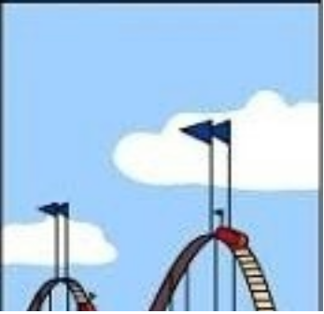




Why to Study
Software Engineering?
Software
Development
Life
Cycle
without
Software
Engineering
5
How the Business Consultant describe it
6
7
8
How the Customer was
billed
How the
Project was documented
What
Operations
Installed
© LPU :: CAP437: SOFTWARE ENGINEERING PRACTICES : Ashwani Kumar Tewari

Slide 7


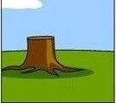
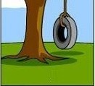
Why to Study Software Engineering?
Software Development Life Cycle without Software Engineering
9
How it was supported
10
What the customer really needed
Software development Process needs to be engineered to avoid
the communication gape
& to meet the actual requirement of customer within stipulated budget
& time
© LPU :: CAP437: SOFTWARE ENGINEERING PRACTICES : Ashwani Kumar Tewari

Slide 8
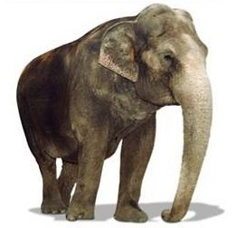
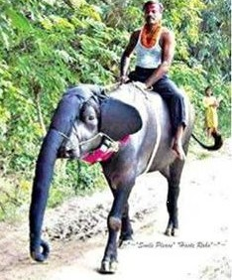
SDLC without
Software Engineering
Customer Requirement
Solution
•
•
•
Have one trunk
Have four legs
Should carry load both passenger & cargo Black in color
Should be herbivorous
•
•
•
Have one trunk
Have four legs
Should carry load both passenger
& cargo
Black in color
Should be herbivorous
•
•
•
•
Our value
added Also gives milk
© LPU :: CAP437: SOFTWARE ENGINEERING PRACTICES : Ashwani Kumar Tewari

Slide 9
Why Software Engineering
?
_ Change in nature & complexity of software
_
Concept of one “guru” is over
_
We all want improvement
Ready for change
2
© LPU :: CAP437: SOFTWARE ENGINEERING PRACTICES : Ashwani Kumar Tewari

Slide 10
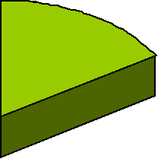

The Evolving Role of Software
Software industry is in Crisis!
success
16%
failure
31%
over budget
53%
Source: The Standish Group International, Inc
(CHAOS research)
© LPU :: CAP437: SOFTWARE ENGINEERING PRACTICES : Ashwani Kumar Tewari

Slide 11
The Evolving Role of Software
This is the
SORRY state of Software Engineering Today!
Successful –
28%
Completed
Late, over budget, and/or with features missing – 49%
Cancelled –
23%
Fewer than 20% of innovation focused projects are coming to life, according to a new report from Oracle, primarily caused by lack of focus and leadership, poor processes, and ongoing resistance to change.
•
© LPU :: CAP437: SOFTWARE ENGINEERING PRACTICES : Ashwani Kumar Tewari

Slide 12
The Evolving Role of Software
As
per
the
IBM report,
“31%of
the project
get
cancelled before
they
are
completed,
53% over-
run
and
their
cost
estimates
by
an
average
of
189%
for
every
100
projects,
there
are
94
restarts”
© LPU :: CAP437: SOFTWARE ENGINEERING PRACTICES : Ashwani Kumar Tewari

Slide 13
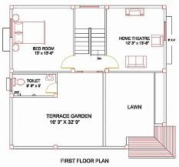
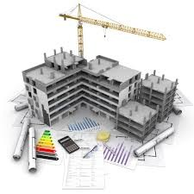
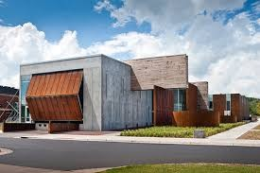
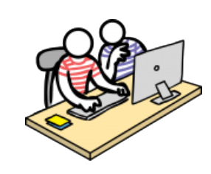
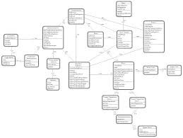
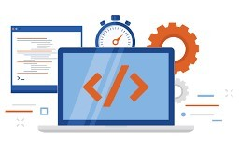
Software Engineering
Engineering
Design
Build
Product
Software Engineering
Software is developed or engineered, it is not manufactured in the classical sense.
© LPU :: CAP437: SOFTWARE ENGINEERING PRACTICES : Ashwani Kumar Tewari

Slide 14
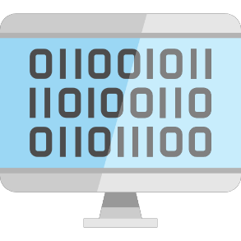


What is Software?
▪
Software is
instructions (computer programs) that when executed provide desired features, function, and performance;
data structures that enable the programs to adequately manipulate information and
documentation that describes the operation and use of the programs.
Computer
Program
Data
Structure
Documents
Soft & Hard
© LPU :: CAP437: SOFTWARE ENGINEERING PRACTICES : Ashwani Kumar Tewari

Slide 15
List
of
Documentation Manuals
Formal Specification
Context Diagram Data Flow Diagram Flow Chart
ER Diagram
Source Code Listings
Cross-Reference Listings
Test Data
Test Results
Darshan Institute of Engineering & Technology
© LPU :: CAP437: SOFTWARE ENGINEERING PRACTICES : Ashwani Kumar Tewari

Slide 16
List
of
Documentation Manuals
System Overview
Beginner’s Guide Tutorials
Reference Guide
Installation Guide
System Administration Guide
© LPU :: CAP437: SOFTWARE ENGINEERING PRACTICES : Ashwani Kumar Tewari

Slide 17
Characteristics of Software
▪
Software is developed or engineered
•
It
•
is not manufactured like hardware
Manufacturing
nonexistent (or
phase
can
introduce
quality
problem
that
are
easily corrected) for software
•
Both
requires
construction
of
“product”
but
approaches
are
different
▪
Software
doesn’t
“wear-out”
Infant
morality
“Wear out”
Failure Rate
Time
Bathtub curve of hardware failure
© LPU :: CAP437: SOFTWARE ENGINEERING PRACTICES : Ashwani Kumar Tewari

Slide 18
Characteristics
of
Software cont.
Change
Increate failure rate due to side effect
Actual Curve
Failure Rate
Idealized Curve
Time
Software failure curve
▪
Although
the
industry
is
moving
toward
component
based
construction, most software continues to be custom built
© LPU :: CAP437: SOFTWARE ENGINEERING PRACTICES : Ashwani Kumar Tewari

Slide 19
Software Characteristics: An Example
Comparison
of
constructing
a
bridge vis-à-vis writing a
program
Sr
No
Constructing a bridge
Writing a program
1
The problem is well understood
Only some parts of the problem are
understood, others are not
2
There are many existing bridges
Every program is different and designed for
special applications
3
The requirement for a bridge typically do not change much during construction
Requirements typically change during all
phases of development
4
The strength and stability of a bridge can be calculated with reasonable precision
Not possible to calculate correctness of a
program with existing methods
5
When a bridge collapses, there is a detailed investigation and report
When a program fails, the reasons are often
unavailable or even deliberately concealed
6
Engineers have been constructing bridges for thousands of years
Developers have been writing programs for 50 years or so
7
Materials (wood, stone,iron, steel) and techniques (making joints in wood, carving stone, casting iron) change slowly
Hardware and software changes rapidly
© LPU :: CAP437: SOFTWARE ENGINEERING PRACTICES : Ashwani Kumar Tewari

Slide 20



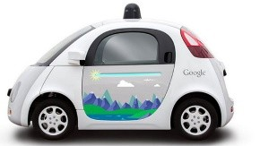



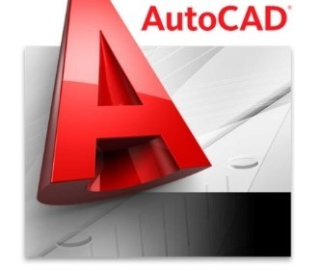




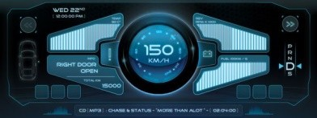

Software Application
Domains
System
Software
Point of Sale,
Customized
Software
Artificial
intelligence
Software
Application
Software
Software
Application
Domains
Web
Application
Engineering
/ Scientific
Software
Product line
Software
Embedded
Software
© LPU :: CAP437: SOFTWARE ENGINEERING PRACTICES : Ashwani Kumar Tewari

Slide 21
Software Engineering
Software engineering is the establishment and use of
sound engineering principles in order to obtain economical software that is reliable and works efficiently in real machines.
The IEEE definition: The application of a systematic, disciplined, quantifiable approach to the development, operation, and maintenance of software, that is the application of engineering to software.
Software Engineering is the science and art of building
and writing programs) a software systems that are:
(designing
1)
2)
3)
4)
on time
on budget
with acceptable Quality With full scope
© LPU :: CAP437: SOFTWARE ENGINEERING PRACTICES : Ashwani Kumar Tewari

Slide 22
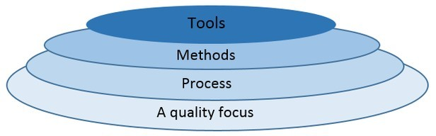
Software Engineering Layered Approach
Software Engineering Tools allows automation of activities
which helps to perform systematic activities. A system for the
support of
software
development,
called
computer-aided
software engineering
Tracking Tools etc…
(CASE).
Examples: Testing Tools, Bug/Issue
It provides technical how-to’s for building software,
it
encompasses many tasks including communication,
requirement
analysis,
design modeling,
program
construction, testing and support
It is a foundation of Software Engineering, It is the glue
the
holds
the
technology
layers,
It
defines
a
framework activities
Defines continuous
process improvement principles
© LPU :: CAP437: SOFTWARE ENGINEERING PRACTICES : Ashwani Kumar Tewari

Slide 23
Software Engineering Cont.
▪
▪
Software Engineering is a layered technology
Quality
•
•
•
Main principle of Software Engineering is Quality Focus.
An engineering approach must have a focus on quality.
Total Quality Management (TQM), Six Sigma, ISO 9001, ISO 9000-
CAPABILITY
MATURITY MODEL
(CMM),
CMMI
&
similar
,
approaches
encourages
a continuous
process
improvement
culture
Process layer
▪
•
•
•
It
It
It
is a foundation of Software Engineering
is the glue the holds the technology layers
defines a framework with activities for effective delivery of
software engineering technology
© LPU :: CAP437: SOFTWARE ENGINEERING PRACTICES : Ashwani Kumar Tewari

Slide 24
Software Engineering Cont.
▪
Method
•
•
It provides technical how-to’s for building software
It
encompasses
many
tasks
including
communication,
requirement
analysis,
design
modeling,
program construction,
testing and support
Tools
▪
•
Computer-aided software
engineering
(CASE) is
the
scientific
application of a set of tools and
methods to a software system
which
is
meant
to
result
in
high-quality,
defect-free,
and
maintainable software products.
CASE tools automate many of the cycle phases.
•
activities involved in various life
© LPU :: CAP437: SOFTWARE ENGINEERING PRACTICES : Ashwani Kumar Tewari

Slide 25
Software Myths (Management Perspectives)
Management may be confident about
good
company
standards and clear procedures of
the
But
the taste of any food
is in the eating;
not in the Recipe !
item
© LPU :: CAP437: SOFTWARE ENGINEERING PRACTICES : Ashwani Kumar Tewari

Slide 26
Software Myths (Management Perspectives)
Company
has
latest
computers
and
state-of-
the-art
software tools, so
we
shouldn‟t
worry
about the quality of the product
The infrastructure is
only one of the several factors that determine the quality
of the product!
© LPU :: CAP437: SOFTWARE ENGINEERING PRACTICES : Ashwani Kumar Tewari

Slide 27
Software Myths
(Management Perspectives)
Addition
of more
software
specialists,
those
may
with
bring
higher
skills
and longer
experience
the schedule back on
the track!
Unfortunately,
may further delay the
that
schedule!
© LPU :: CAP437: SOFTWARE ENGINEERING PRACTICES : Ashwani Kumar Tewari

Slide 28
Software Myths (Management Perspectives)
Software is easy to change
The reality is totally
different
© LPU :: CAP437: SOFTWARE ENGINEERING PRACTICES : Ashwani Kumar Tewari

Slide 29
Software Myths (Developer Perspectives)
Once the software is demonstrated, the job
is
done
Usually, the problems just begin!
© LPU :: CAP437: SOFTWARE ENGINEERING PRACTICES : Ashwani Kumar Tewari

Slide 30
Software Myths (Developer Perspectives)
Software quality can
testing
not
be
assessed
before
However, quality assessment techniques
should be used through out the software development life cycle
© LPU :: CAP437: SOFTWARE ENGINEERING PRACTICES : Ashwani Kumar Tewari

Slide 31
Software Myths (Developer
Perspectives)
The
only
deliverable
for
a
software
development project is
the tested
code
Tested code is only one of
the deliverable!
© LPU :: CAP437: SOFTWARE ENGINEERING PRACTICES : Ashwani Kumar Tewari

Slide 32
End of Class
Let’s Talk
© LPU :: CAP437: SOFTWARE ENGINEERING PRACTICES : Ashwani Kumar Tewari

